Slide 1

Privacy-Preserving Distributed Expectation Maximization for Gaussian Mixture Models
Hana Hasan, Hallel Weinberg, Tidhar Rettig
Prof. Adi Akavia's Secure Cloud Computing Laboratory, Fall 2022-2023

Slide 2
Introduction
Background
Proposed Approach

Slide 3
Introduction
In recent years, cloud computing has emerged as a ubiquitous and cost-effective solution for storing and processing large volumes of data. However, the outsourcing of data to remote servers in the cloud raises concerns about data privacy and security. As data breaches and privacy violations become increasingly common, there is a growing need for secure cloud computing solutions that can ensure the confidentiality, integrity, and availability of data.

Slide 4
Introduction
One of the major challenges in secure cloud computing is the need to preserve the privacy of sensitive data while allowing for meaningful analysis. In this paper, we propose a privacy-preserving distributed expectation-maximization algorithm for Gaussian mixture models. Our method involves utilizing fully homomorphic encryption to facilitate a privacy-preserving centralized federated learning approach.

Slide 5
Introduction
Background
Proposed Approach

Slide 6
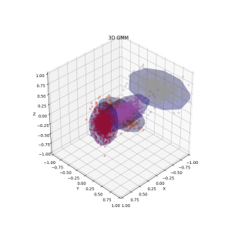
Gaussian Mixture Models (GMM)

Slide 7
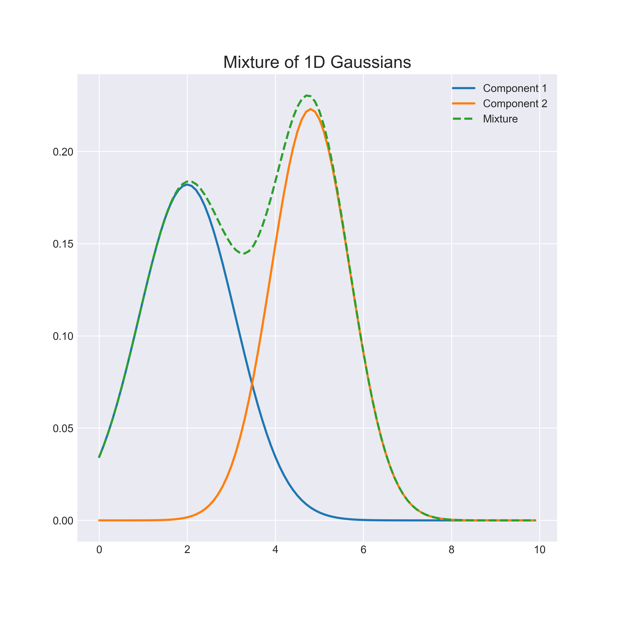
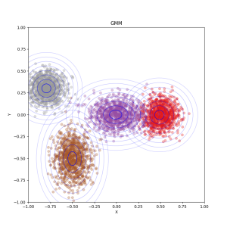
Gaussian Mixture Models (GMM)
A Gaussian mixture model is a probabilistic model that assumes all the data points are generated from a mixture of a finite number of Gaussian distributions with unknown parameters.

Slide 8
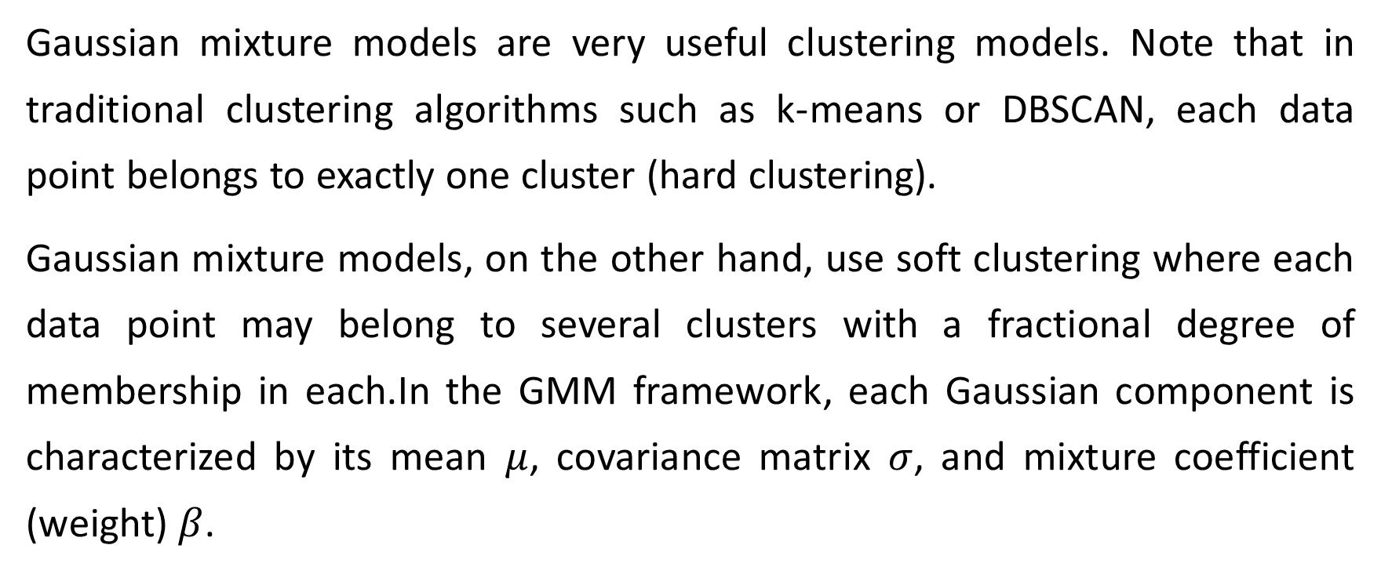
Gaussian Mixture Models (GMM)
Gaussian mixture models are very useful clustering models. Note that in traditional clustering algorithms such as k-means or DBSCAN, each data point belongs to exactly one cluster (hard clustering).
Gaussian mixture models, on the other hand, use soft clustering where each data point may belong to several clusters with a fractional degree of membership in each.In the GMM framework, each Gaussian component is characterized by its mean $μ$, covariance matrix $σ$, and mixture coefficient (weight) $β$.

Slide 9
Expectation Maximization (EM)

Slide 10
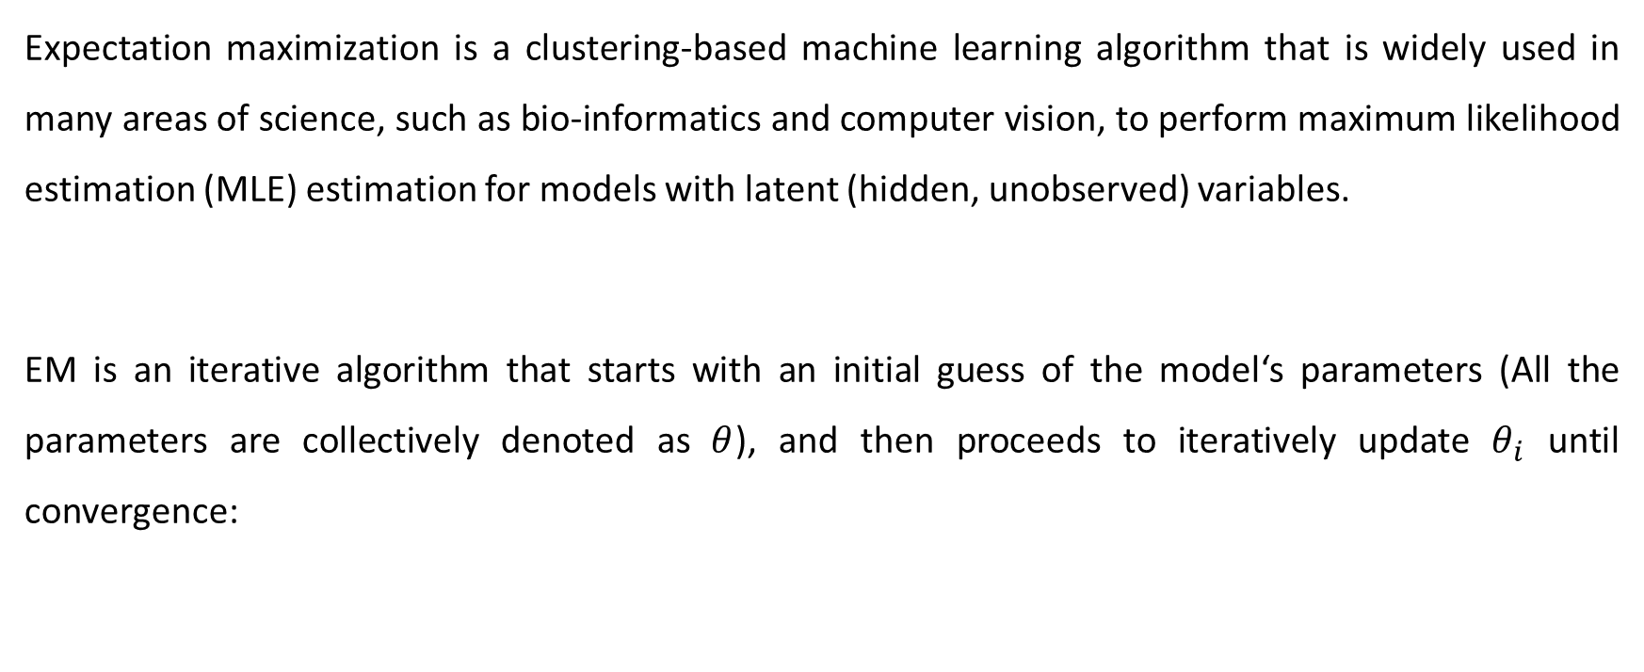
Expectation Maximization (EM)
Expectation maximization is a clustering-based machine learning algorithm that is widely used in many areas of science, such as bio-informatics and computer vision, to perform maximum likelihood estimation (MLE) estimation for models with latent (hidden, unobserved) variables.
EM is an iterative algorithm that starts with an initial guess of the model‘s parameters (All the parameters are collectively denoted as $θ$), and then proceeds to iteratively update $θ_{i}$ until convergence:

Slide 11
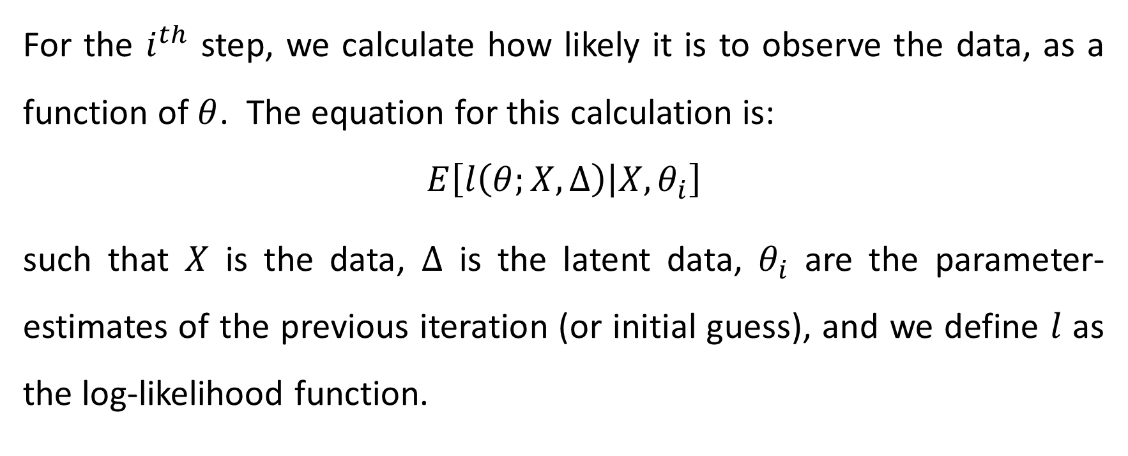
E-Step
For the $i^{th}$ step, we calculate how likely it is to observe the data, as a function of $θ$. The equation for this calculation is:
$$E\left[l\left(θ;X,∆\right) | X,θ_{i}\right]$$
such that $X$ is the data, $Δ$ is the latent data, $θ_{i}$ are the parameter-estimates of the previous iteration (or initial guess), and we define $l$ as the log-likelihood function.

Slide 12
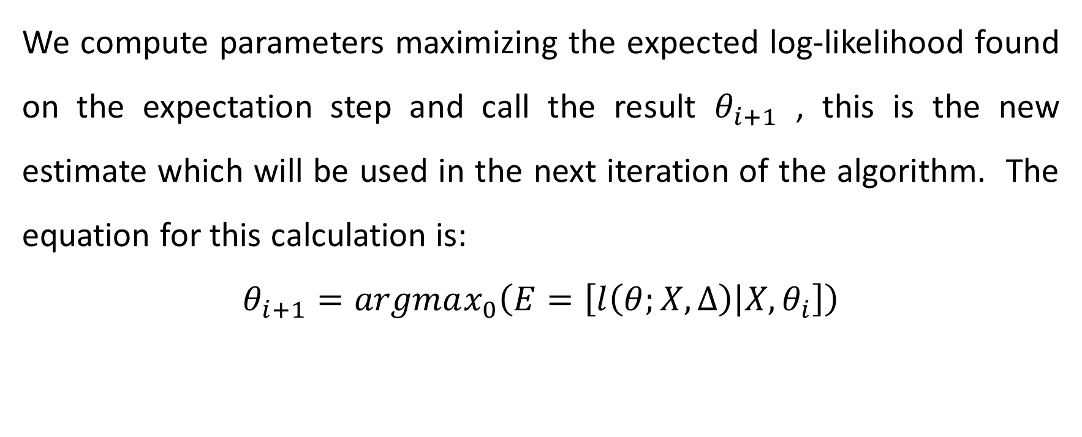
M-Step
We compute parameters maximizing the expected log-likelihood found on the expectation step and call the result $θ_{i+1}$ , this is the new estimate which will be used in the next iteration of the algorithm. The equation for this calculation is:
$$θ_{i+1}=argmax_{0}\left(E=\left[l\left(θ;X,∆\right) | X,θ_{i}\right]\right)$$

Slide 13
Expectation Maximization for GMM

Slide 14
Expectation-Maximization for GMM
The expectation maximization algorithm can be applied to estimate the parameters of a G
In the case of a GMM, the E-step involves computing the posterior probabilities of each data point belonging to each of the Gaussian components. These probabilities are used to update the estimates of the mixture weights and the means and covariances of each Gaussian component in the M-step. Gaussian mixture model given a set of observed data.

Slide 15
Distributed Expectation Maximization for GMM

Slide 16
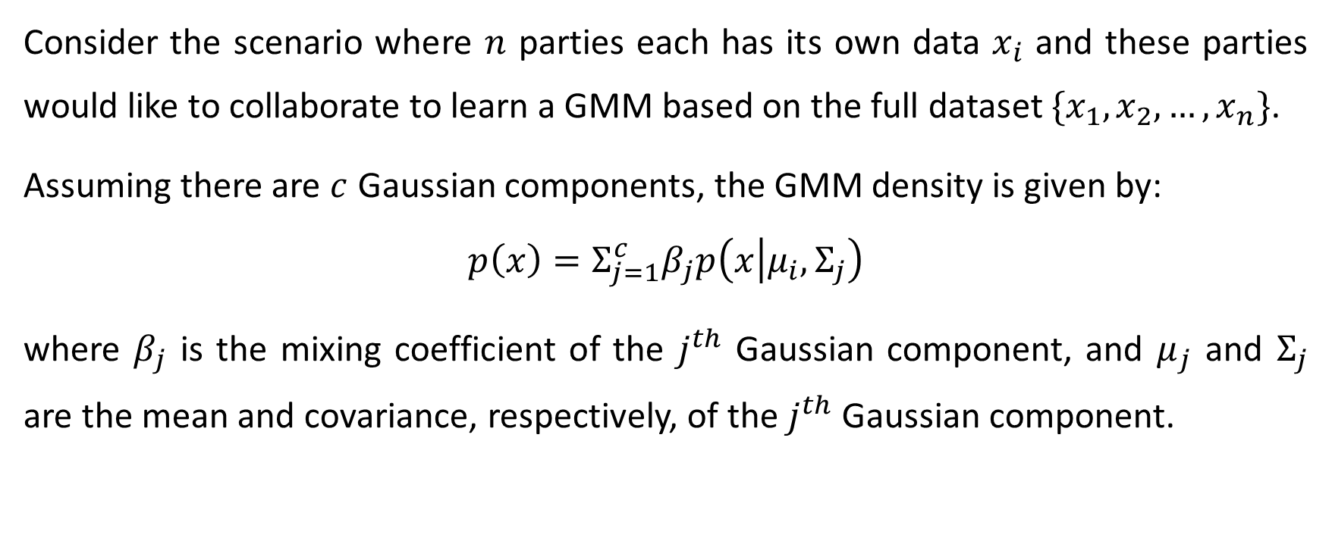
Distributed EM for GMM
Consider the scenario where $n$ parties each has its own data $x_{i}$ and these parties would like to collaborate to learn a GMM based on the full dataset $\{x_{1},x_{2},…,x_{n}\}$.
Assuming there are $c$ Gaussian components, the GMM density is given by:
$$p\left(x\right)=Σ_{j=1}^{c}β_{j}p\left(x | μ_{i},Σ_{j}\right)$$
where $β_{j}$ is the mixing coefficient of the $j^{th}$ Gaussian component, and $μ_{j}$ and $Σ_{j}$ are the mean and covariance, respectively, of the $j^{th}$ Gaussian component.

Slide 17

Distributed EM for GMM
The EM algorithm is iterative and for each iteration $t$, the following steps are taken for all Gaussian components:

Slide 18
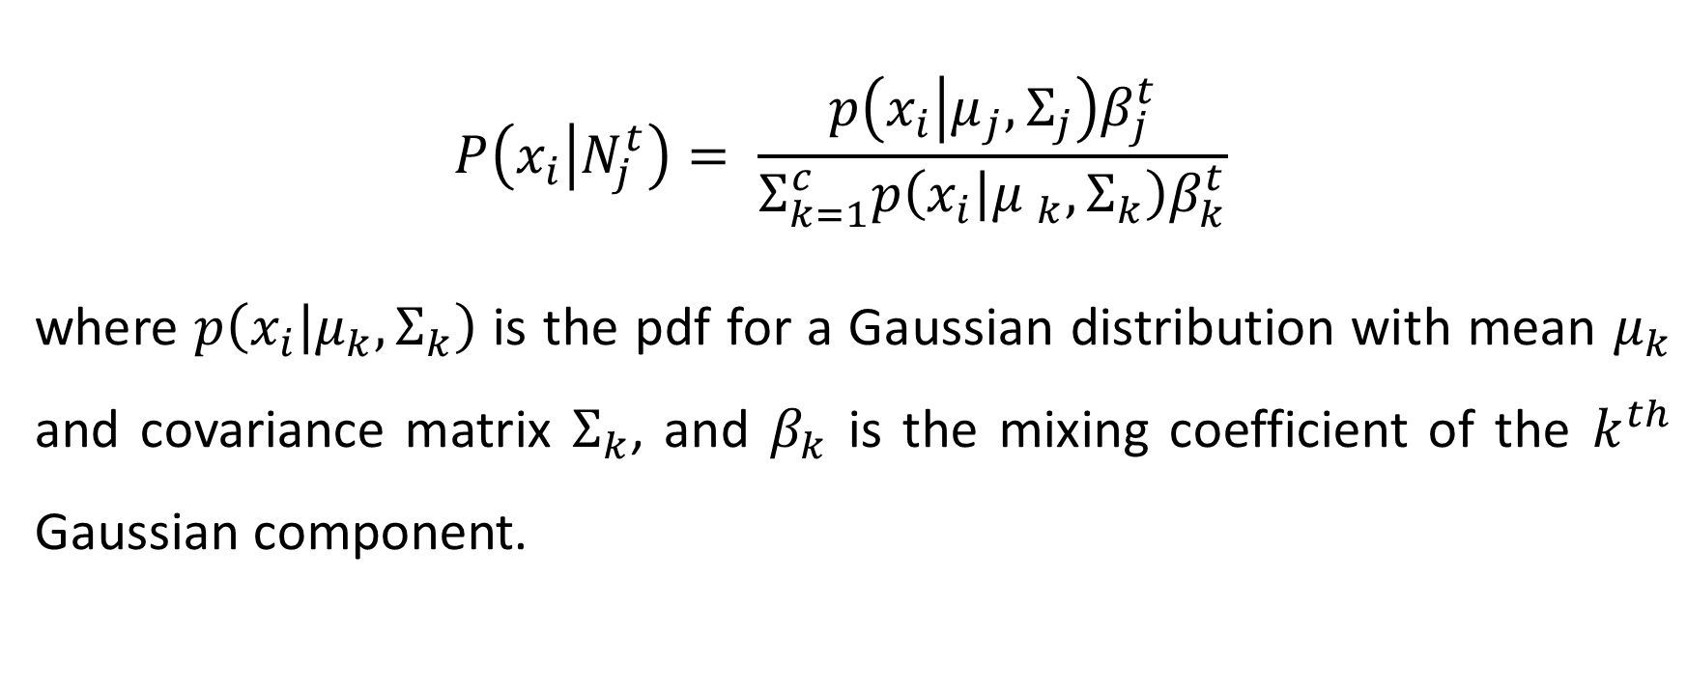
E-Step
$$P\left(x_{i} | N_{j}^{t}\right)= \frac{{p\left(x_{i} | μ_{j}, Σ_{j}\right)β}_{j}^{t}}{{Σ_{k=1}^{c}p\left(x_{i} | {μ }_{k}, Σ_{k}\right)β}_{k}^{t}}$$
where $p\left(x_{i} | μ_{k}, Σ_{k}\right)$ is the pdf for a Gaussian distribution with mean $μ_{k}$ and covariance matrix $Σ_{k}$, and $β_{k}$ is the mixing coefficient of the $k^{th}$ Gaussian component.

Slide 19
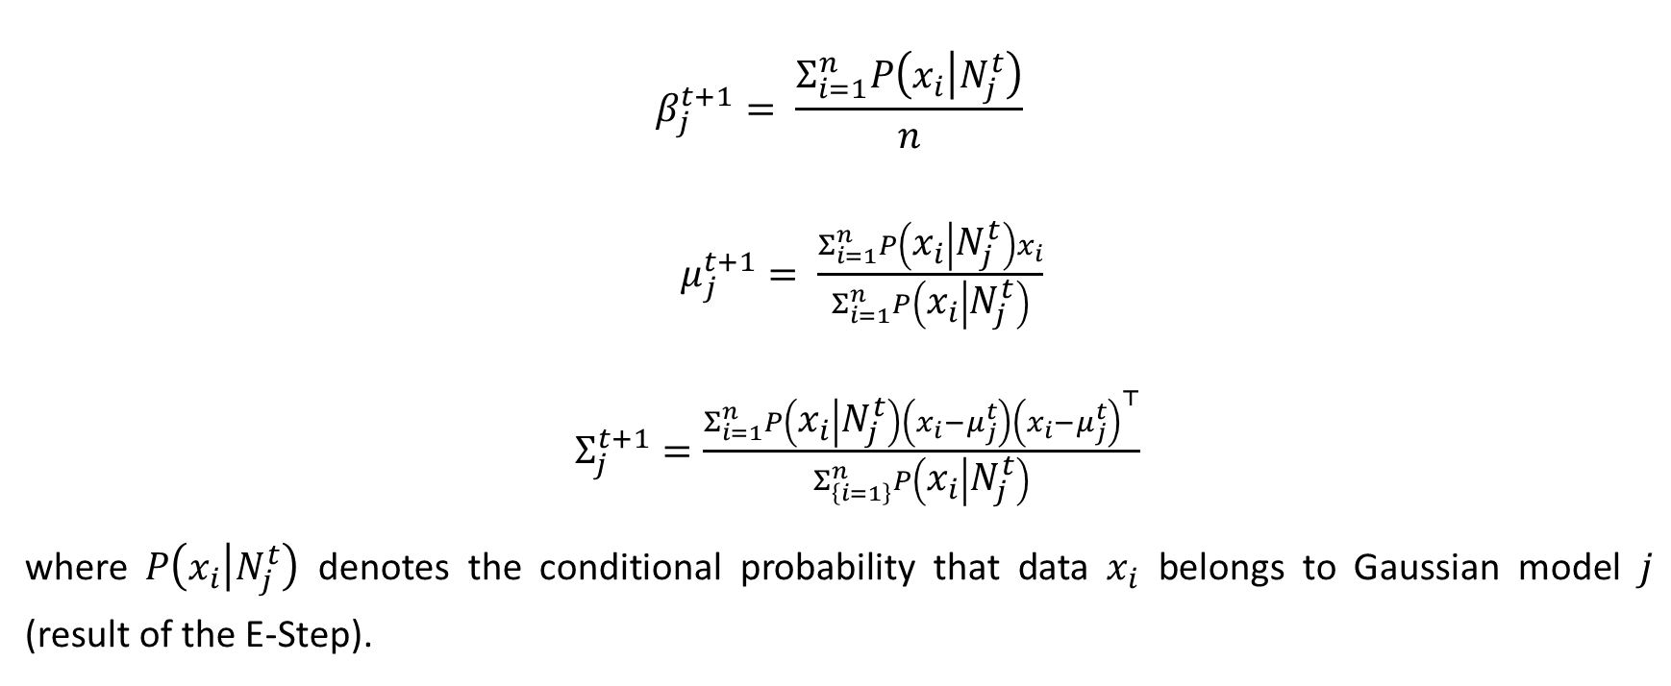
M-Step
$$β_{j}^{t+1}= \frac{Σ_{i=1}^{n}P\left(x_{i} | N_{j}^{t}\right)}{n}$$
$μ_{j}^{t+1}= \frac{Σ_{i=1}^{n}P\left(x_{i} | N_{j}^{t}\right)x_{i}}{Σ_{i=1}^{n}P\left(x_{i} | N_{j}^{t}\right)}$
$Σ_{j}^{t+1}=\frac{Σ_{i=1}^{n}P\left(x_{i} | N_{j}^{t}\right)\left(x_{i}−μ_{j}^{t}\right){\left(x_{i}−μ_{j}^{t}\right)}^{⊤}}{Σ_{\left\{i=1\right\}}^{n}P\left(x_{i} | N_{j}^{t}\right)}$
where $P\left(x_{i} | N_{j}^{t}\right)$ denotes the conditional probability that data $x_{i}$ belongs to Gaussian model $j$ (result of the E-Step).

Slide 20
Privacy-Preserving Expectation Maximization (PPEM)

Slide 21
Privacy-Preserving EM (PPEM)
To deploy such an algorithm in cloud environments, security and privacy issues need be considered to avoid data breaches or abuses by external malicious parties or even by cloud service providers.

Slide 22
Existing approaches for PPEM:
Differential Privacy (DP) based PPEM: The DP-based PPEM approaches perturb the data to prevent sensitive information from being leaked. One such approach is the DP-EM algorithm that adds noise to the EM algorithm's update steps to ensure differential privacy.
Homomorphic Encryption (HE) based PPEM: Homomorphic encryption allows computation on encrypted data without decryption, enabling privacy-preserving computation. The HE-based PPEM approaches encrypt the data before using the EM algorithm, ensuring that sensitive information is not leaked.

Slide 23
Existing approaches for PPEM:
Federated Learning based PPEM: Federated Learning is a machine learning technique that enables training on decentralized data. The Federated EM algorithm is a variant of the EM algorithm that uses Federated Learning to train a model on multiple devices without centralizing the data.
Secure Multi-Party Computation (SMPC) based PPEM: Secure Multi-Party Computation (SMPC) is a cryptographic protocol that allows multiple parties to compute a function while keeping their inputs private. SMPC-based PPEM approaches enable multiple parties to run the EM algorithm on their local data without sharing it, ensuring privacy.

Slide 24
Fully Homomorphic Encryption (FHE) and the CKKS scheme

Slide 25

Fully Homomorphic Encryption (FHE) and the CKKS scheme
Acknowledgement: Our project uses the TenSEAL library, which is an open-source library for homomorphic encryption in Python.

Slide 26
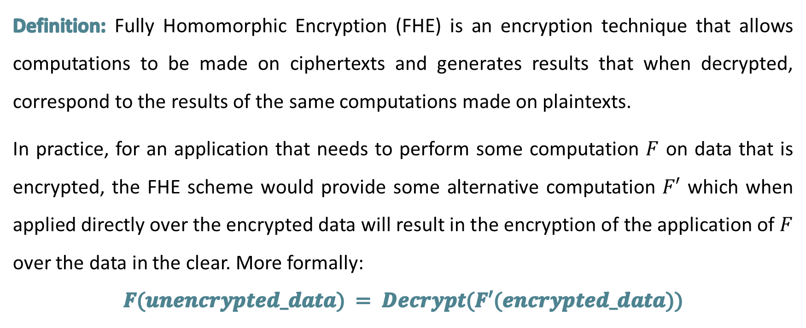
Fully Homomorphic Encryption (FHE)
Definition: Fully Homomorphic Encryption (FHE) is an encryption technique that allows computations to be made on ciphertexts and generates results that when decrypted, correspond to the results of the same computations made on plaintexts.
In practice, for an application that needs to perform some computation $F$ on data that is encrypted, the FHE scheme would provide some alternative computation $F′$ which when applied directly over the encrypted data will result in the encryption of the application of $F$ over the data in the clear. More formally:
$$F(unencrypted_data) = Decrypt(F′(encrypted_data))$$

Slide 27
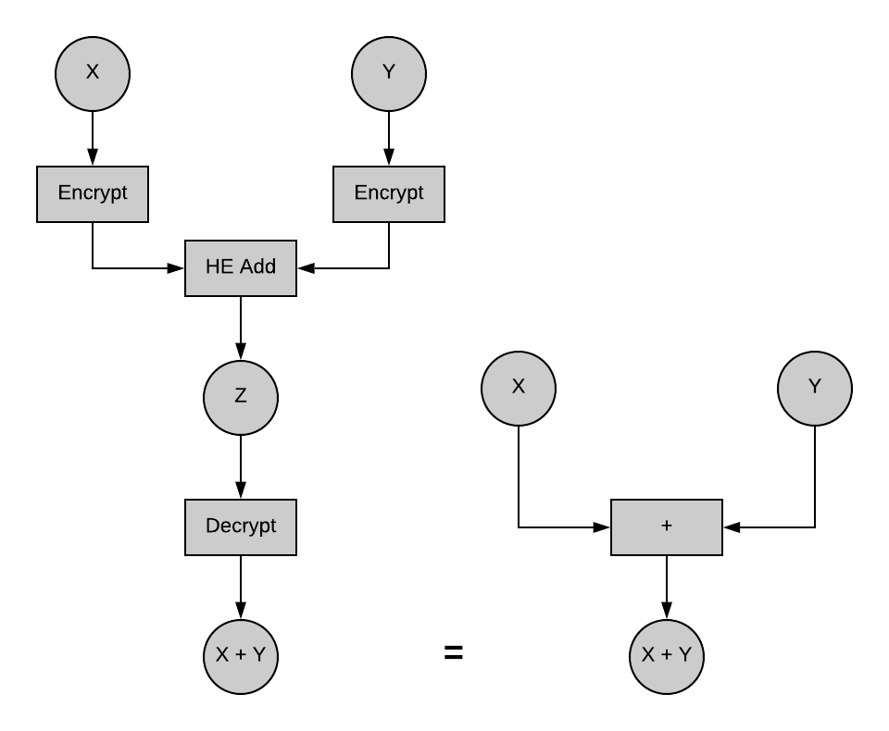
Fully Homomorphic Encryption (FHE)

Slide 28
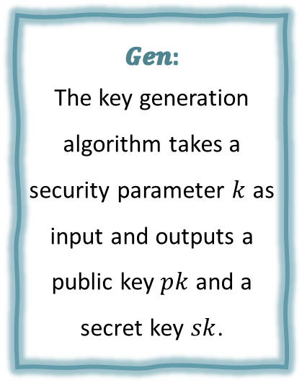



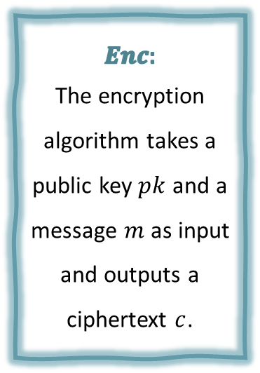
Fully Homomorphic Encryption (FHE)
Formally, an FHE scheme is a tuple of four algorithms $(Gen, Enc, Dec, Eval)$ that satisfy the following properties:
$$Gen:$$
The key generation algorithm takes a security parameter $k$ as input and outputs a public key $pk$ and a secret key $sk$.
$$Enc:$$
The encryption algorithm takes a public key $pk$ and a message $m$ as input and outputs a ciphertext $c$.
$$Dec:$$
The decryption algorithm takes a secret key $sk$ and a ciphertext $c$ as input and outputs the original message $m$.
$$Eval:$$
The evaluation algorithm takes a function f and a set of ciphertexts $\{c_{1}, c_{2}, …, c_{n}\}$ as input and outputs a new ciphertext $c_{f}$ that represents the result of applying the function f to the plaintexts corresponding to the input ciphertexts.

Slide 29


Fully Homomorphic Encryption (FHE)
For an FHE scheme to be fully homomorphic, the Eval algorithm must satisfy two additional properties:
$$Correctness:$$
For any function f and any set of ciphertexts $\{c_{1}, c_{2}, …, c_{n}\}$ corresponding to plaintexts $\{m_{1}, m_{2}, …, m_{n}$, the ciphertext $c_{f}$ output by $Eval\left(pk, f, \left\{c_{1}, c_{2}, …, c_{n}\right\}\right)$ must decrypt to the correct result $f(m_{1}, m_{2}, …, m_{n})$.
$$Security:$$
The scheme must provide a level of security that makes it infeasible for an attacker to learn any information about the plaintexts from the ciphertexts or the public key.

Slide 30
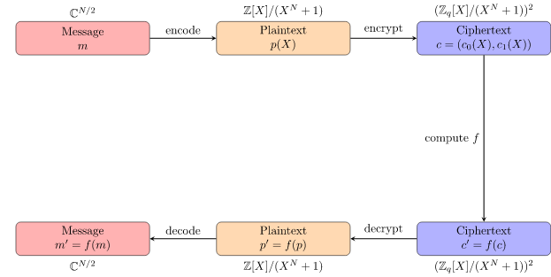
CKKS scheme
Definition: Cheon-Kim-Kim-Song(CKKS) is a scheme for Leveled Homomorphic Encryption that supports approximate arithmetics over complex numbers (hence, real numbers).

Slide 31
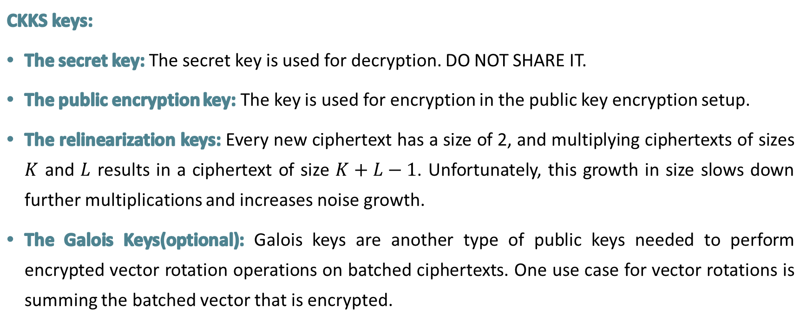
CKKS scheme
CKKS keys:
The secret key: The secret key is used for decryption. DO NOT SHARE IT.
The public encryption key: The key is used for encryption in the public key encryption setup.
The relinearization keys: Every new ciphertext has a size of 2, and multiplying ciphertexts of sizes $K$ and $L$ results in a ciphertext of size $K+L−1$. Unfortunately, this growth in size slows down further multiplications and increases noise growth.
The Galois Keys(optional): Galois keys are another type of public keys needed to perform encrypted vector rotation operations on batched ciphertexts. One use case for vector rotations is summing the batched vector that is encrypted.

Slide 32
CKKS scheme
Note:
Relinearization is the operation that reduces the size of ciphertexts back to 2. This operation requires another type of public keys, the relinearization keys created by the secret key owner.
The operation is needed for encrypted multiplications. The plain multiplication is fundamentally different from normal multiplication and does not result in ciphertext size growth.

Slide 33
Adversary Models
Adversary models are used to describe the capabilities and goals of attackers who may attempt to compromise the security of the system, such as:
Semi-Honest ("honest, but curious"): All parties follow protocol instructions, but dishonest parties may be curious to violate privacy of others when possible.
Fully Malicious Model: Adversarial Parties may deviate from the protocol arbitrarily (quit unexpectedly, send different messages etc). It is much harder to achieve security in the fully malicious model.

Slide 34
Introduction
Background
Proposed Approach

Slide 35

Motivation

Slide 36
Motivation
All proposed approaches in prior work on PPEM involve a trade-off between accuracy, privacy, and performance.
For example, Fully Homomorphic Encryption (FHE) based algorithms can be time consuming and computationally heavy as computing over encrypted data incurs a high computational overhead, however privacy will be maintained as FHE allows for secure computations on encrypted data without requiring access to the plaintext.

Slide 37
Motivation
Another example is Secure Multi-Party Computation (SMPC) based PPEM: maintaining privacy is a primary goal of SMPC. However, achieving perfect privacy comes at the cost of computational complexity and performance, and the efficiency of SMPC can be impacted by the number of parties involved in the computation.

Slide 38

Our Contribution

Slide 39
Our Contribution
We propose a protocol for privacy-preserving expectation maximization that attains the desirable properties of FHE while simplifying calculations to only require addition operations on encrypted data. This approach allows us to achieve a high level of privacy while also improving performance and reducing computational overhead.
By utilizing the strengths of FHE while streamlining the computation process, we are able to strike a balance between accuracy, privacy, and performance in our proposed approach.

Slide 40

Settings

Slide 41
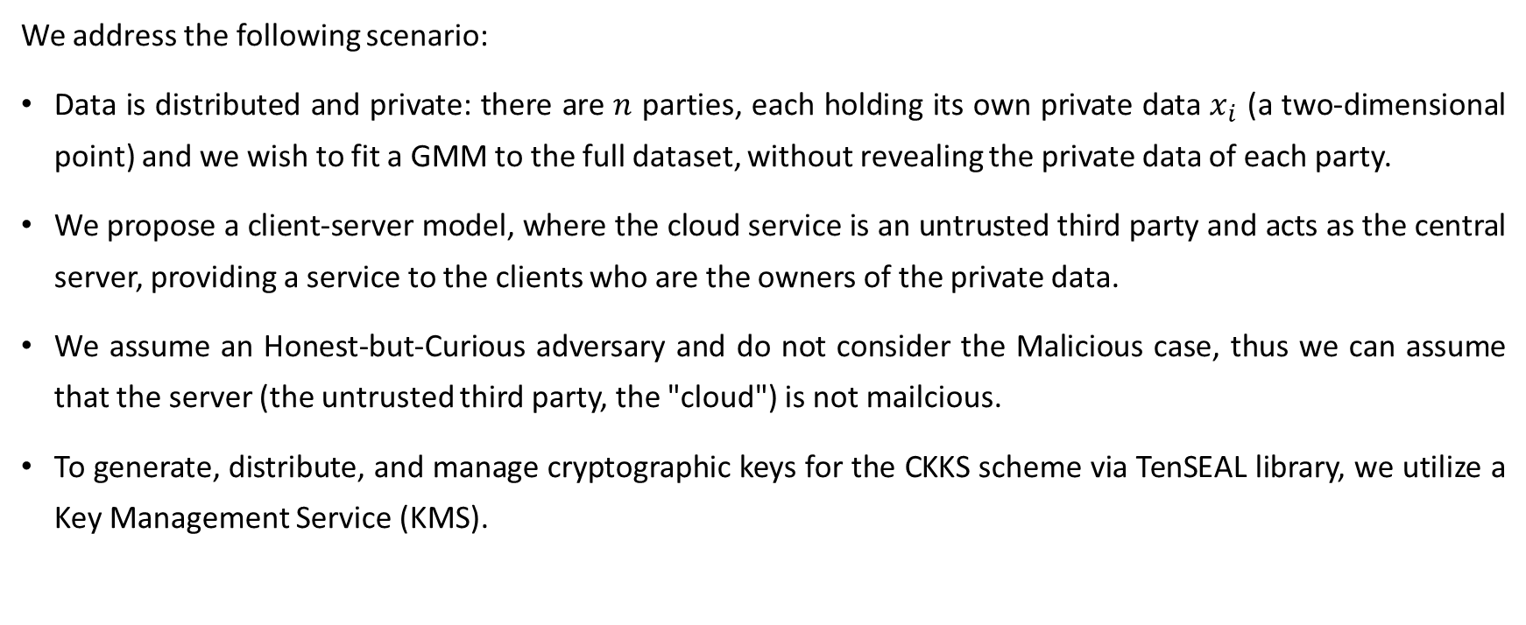
Settings
We address the following scenario:
Data is distributed and private: there are $n$ parties, each holding its own private data $x_{i}$ (a two-dimensional point) and we wish to fit a GMM to the full dataset, without revealing the private data of each party.
We propose a client-server model, where the cloud service is an untrusted third party and acts as the central server, providing a service to the clients who are the owners of the private data.
We assume an Honest-but-Curious adversary and do not consider the Malicious case, thus we can assume that the server (the untrusted third party, the "cloud") is not mailcious.
To generate, distribute, and manage cryptographic keys for the CKKS scheme via TenSEAL library, we utilize a Key Management Service (KMS).

Slide 42

Reminder

Slide 43
Reminder: Distributed EM for GMM
Consider the scenario where $n$ parties each has its own data $x_{i}$ and these parties would like to collaborate to learn a GMM based on the full dataset $\{x_{1},x_{2},…,x_{n}\}$.
Assuming there are $c$ Gaussian components, the GMM density is given by:
$$p\left(x\right)=Σ_{j=1}^{c}β_{j}p\left(x | μ_{i},Σ_{j}\right)$$
where $β_{j}$ is the mixing coefficient of the $j^{th}$ Gaussian component, and $μ_{j}$ and $Σ_{j}$ are the mean and covariance, respectively, of the $j^{th}$ Gaussian component.

Slide 44
Reminder: Distributed EM for GMM
The EM algorithm is iterative and for each iteration $t$, the following steps are taken for all Gaussian components:

Slide 45
E-Step
$$P\left(x_{i} | N_{j}^{t}\right)= \frac{{p\left(x_{i} | μ_{j}, Σ_{j}\right)β}_{j}^{t}}{{Σ_{k=1}^{c}p\left(x_{i} | {μ }_{k}, Σ_{k}\right)β}_{k}^{t}}$$
where $p\left(x_{i} | μ_{k}, Σ_{k}\right)$ is the pdf for a Gaussian distribution with mean $μ_{k}$ and covariance matrix $Σ_{k}$, and $β_{k}$ is the mixing coefficient of the $k^{th}$ Gaussian component.

Slide 46
M-Step
$$β_{j}^{t+1}= \frac{Σ_{i=1}^{n}P\left(x_{i} | N_{j}^{t}\right)}{n}$$
$μ_{j}^{t+1}= \frac{Σ_{i=1}^{n}P\left(x_{i} | N_{j}^{t}\right)x_{i}}{Σ_{i=1}^{n}P\left(x_{i} | N_{j}^{t}\right)}$
$Σ_{j}^{t+1}=\frac{Σ_{i=1}^{n}P\left(x_{i} | N_{j}^{t}\right)\left(x_{i}−μ_{j}^{t}\right){\left(x_{i}−μ_{j}^{t}\right)}^{⊤}}{Σ_{\left\{i=1\right\}}^{n}P\left(x_{i} | N_{j}^{t}\right)}$
where $P\left(x_{i} | N_{j}^{t}\right)$ denotes the conditional probability that data $x_{i}$ belongs to Gaussian model $j$ (result of the E-Step).

Slide 47

Our Approach

Slide 48
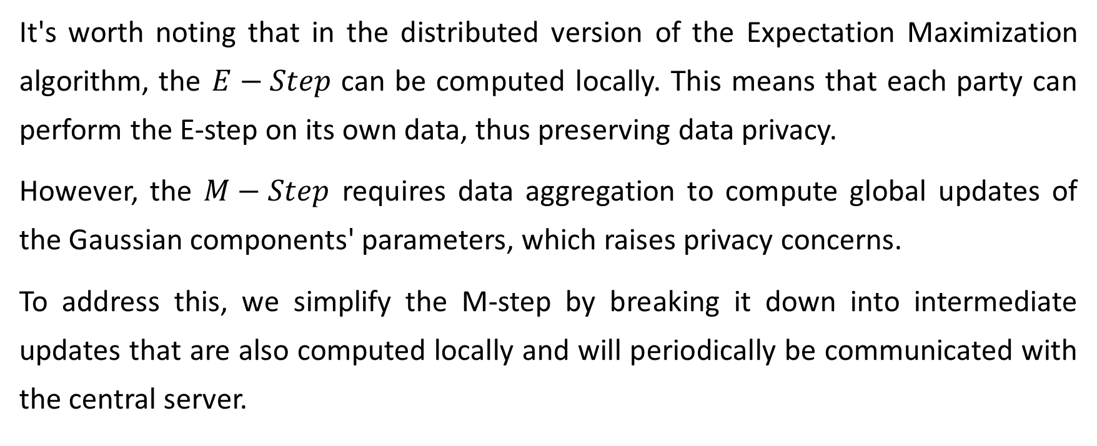
Our Approach
It's worth noting that in the distributed version of the Expectation Maximization algorithm, the $E−Step$ can be computed locally. This means that each party can perform the E-step on its own data, thus preserving data privacy.
However, the $M−Step$ requires data aggregation to compute global updates of the Gaussian components' parameters, which raises privacy concerns.
To address this, we simplify the M-step by breaking it down into intermediate updates that are also computed locally and will periodically be communicated with the central server.

Slide 49
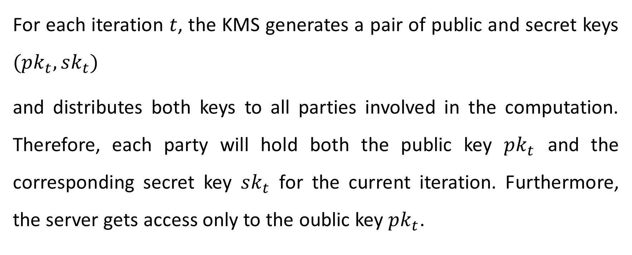
The Algorithm
For each iteration $t$, the KMS generates a pair of public and secret keys $(pk_{t}, sk_{t})$
and distributes both keys to all parties involved in the computation. Therefore, each party will hold both the public key $pk_{t}$ and the corresponding secret key $sk_{t}$ for the current iteration. Furthermore, the server gets access only to the oublic key $pk_{t}$.

Slide 50
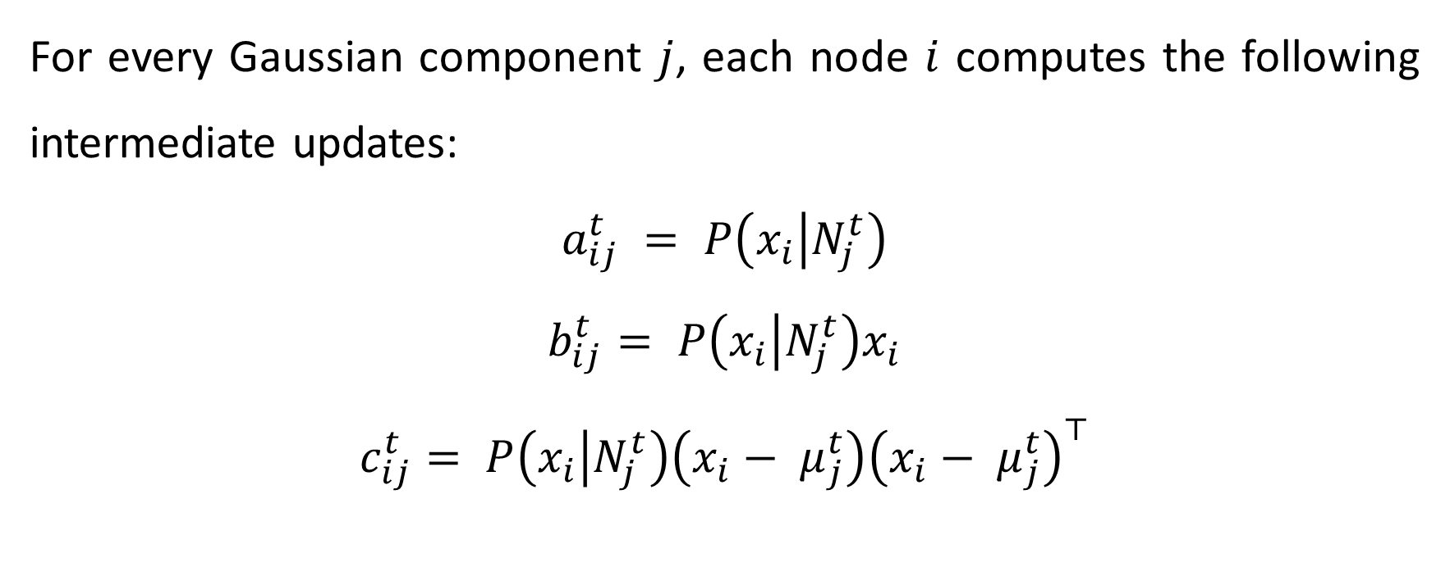
The Algorithm
For every Gaussian component $j$, each node $i$ computes the following intermediate updates:
$$a_{ij}^{t} = P\left(x_{i} | N_{j}^{t}\right)$$
$$b_{ij}^{t}= P\left(x_{i} | N_{j}^{t}\right)x_{i}$$
$$c_{ij}^{t}= P\left(x_{i} | N_{j}^{t}\right)\left(x_{i}− μ_{j}^{t}\right){\left(x_{i}− μ_{j}^{t}\right)}^{⊤}$$

Slide 51
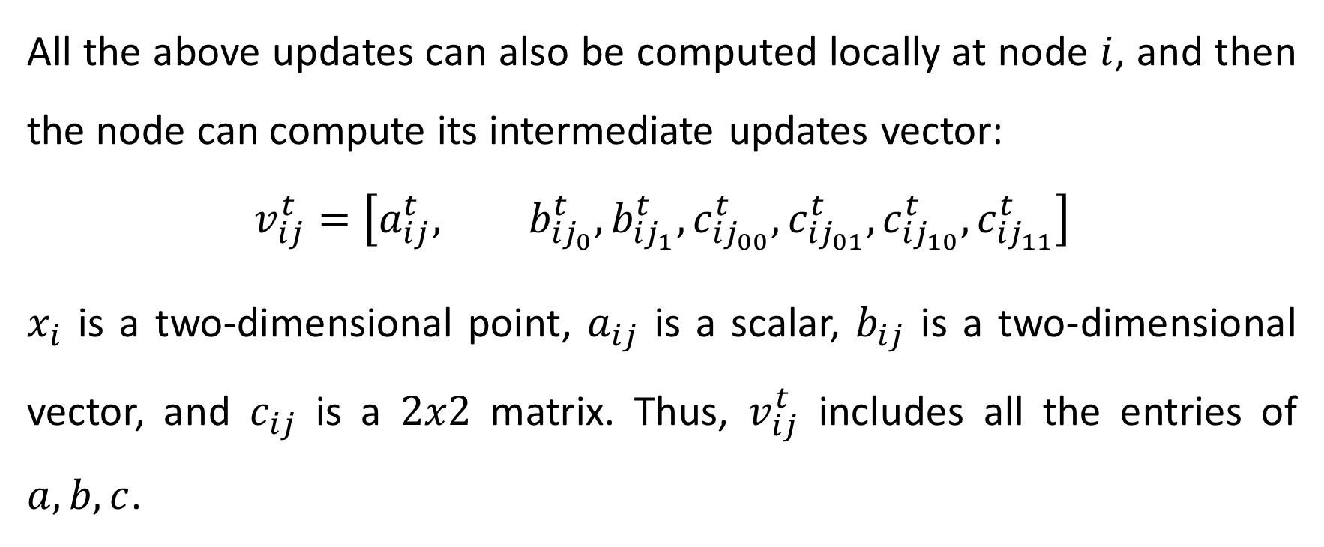
The Algorithm
All the above updates can also be computed locally at node $i$, and then the node can compute its intermediate updates vector:
$$v_{ij}^{t}=\left[a_{ij}^{t}, b_{{ij}_{0}}^{t}, b_{{ij}_{1}}^{t}, c_{{ij}_{00}}^{t}, c_{{ij}_{01}}^{t}, c_{{ij}_{10}}^{t}, c_{{ij}_{11}}^{t}\right]$$
$x_{i}$ is a two-dimensional point, $a_{ij}$ is a scalar, $b_{ij}$ is a two-dimensional vector, and $c_{ij}$ is a $2x2$ matrix. Thus, $v_{ij}^{t}$ includes all the entries of $a, b, c$.

Slide 52
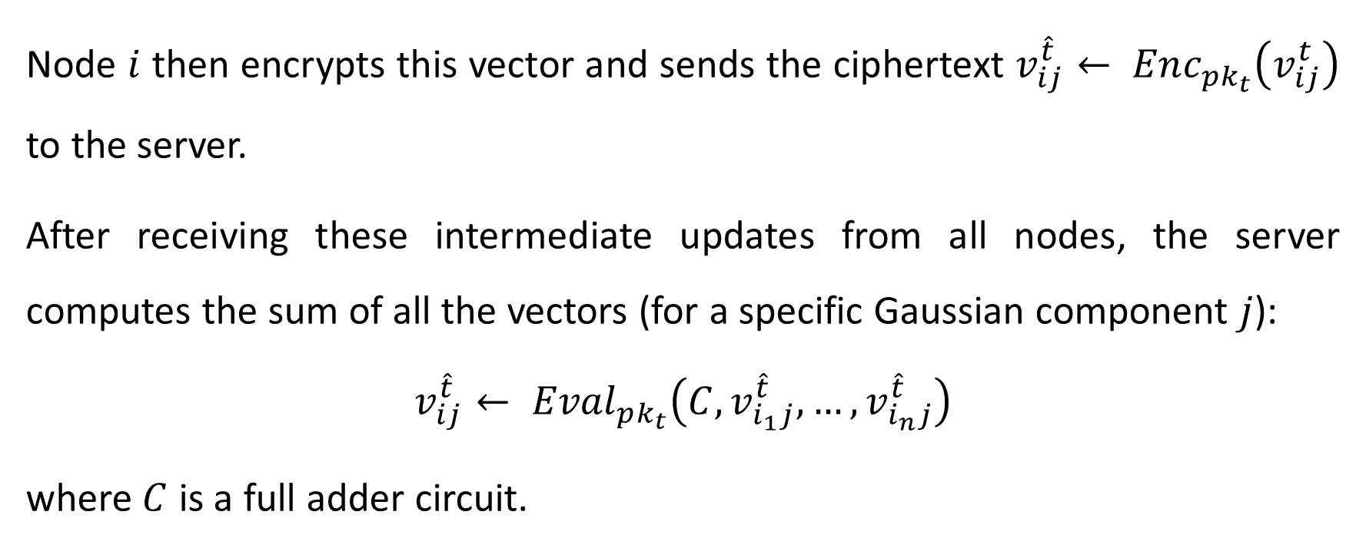
The Algorithm
Node $i$ then encrypts this vector and sends the ciphertext $v_{ij}^{\hat{t}}← Enc_{pk_{t}}\left(v_{ij}^{t}\right)$ to the server.
After receiving these intermediate updates from all nodes, the server computes the sum of all the vectors (for a specific Gaussian component $j$):
$$v_{ij}^{\hat{t}}← {Eval}_{pk_{t}}\left(C,v_{i_{1}j}^{\hat{t}},…,v_{i_{n}j}^{\hat{t}}\right)$$
where $C$ is a full adder circuit.

Slide 53
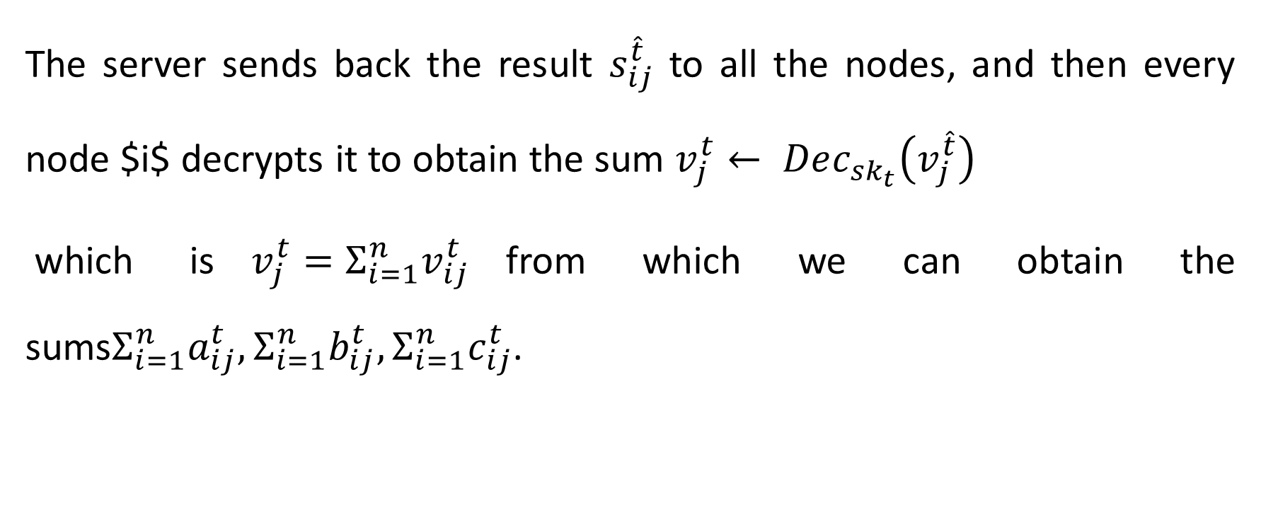
The Algorithm
The server sends back the result $s_{ij}^{\hat{t}}$ to all the nodes, and then every node $i$ decrypts it to obtain the sum $v_{j}^{t}← Dec_{sk_{t}}\left(v_{j}^{\hat{t}}\right)$
which is$v_{j}^{t}=Σ_{i=1}^{n}v_{ij}^{t}$from which we can obtain the sums$Σ_{i=1}^{n}a_{ij}^{t},Σ_{i=1}^{n}b_{ij}^{t},Σ_{i=1}^{n}c_{ij}^{t}$.

Slide 54
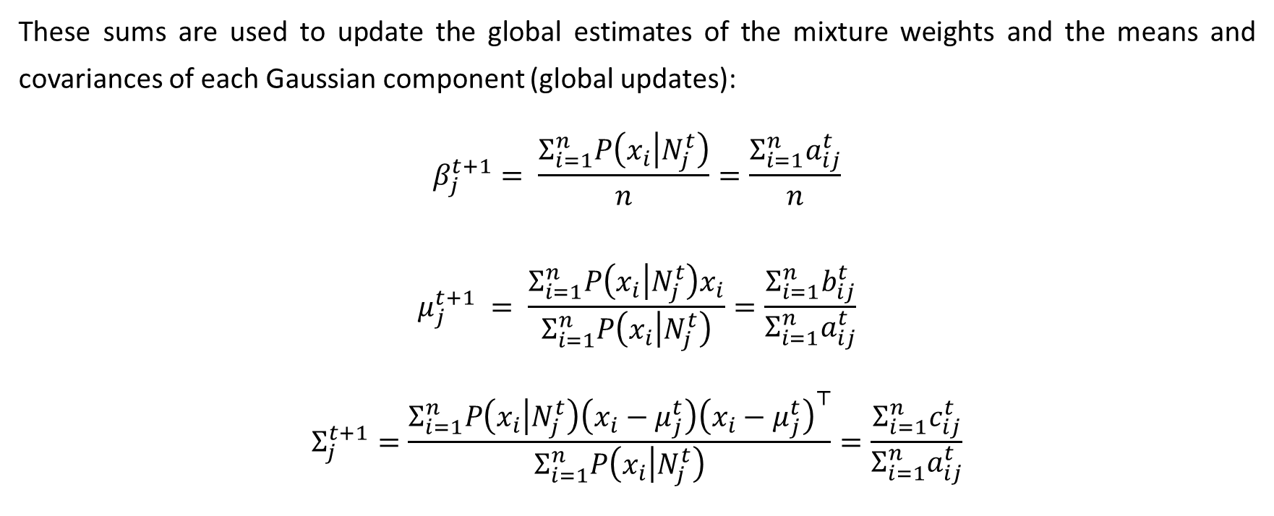
The Algorithm
These sums are used to update the global estimates of the mixture weights and the means and covariances of each Gaussian component (global updates):
$$β_{j}^{t+1}= \frac{Σ_{i=1}^{n}P\left(x_{i} | N_{j}^{t}\right)}{n}=\frac{Σ_{i=1}^{n}a_{ij}^{t}}{n}$$
$$μ_{j}^{t+1} = \frac{Σ_{i=1}^{n}P\left(x_{i} | N_{j}^{t}\right)x_{i}}{Σ_{i=1}^{n}P\left(x_{i} | N_{j}^{t}\right)}=\frac{Σ_{i=1}^{n}b_{ij}^{t}}{Σ_{i=1}^{n}a_{ij}^{t}}$$
$$Σ_{j}^{t+1}=\frac{Σ_{i=1}^{n}P\left(x_{i} | N_{j}^{t}\right)\left(x_{i}−μ_{j}^{t}\right){\left(x_{i}−μ_{j}^{t}\right)}^{⊤}}{Σ_{i=1}^{n}P\left(x_{i} | N_{j}^{t}\right)}=\frac{Σ_{i=1}^{n}c_{ij}^{t}}{Σ_{i=1}^{n}a_{ij}^{t}}$$

Slide 55

Results

Slide 56
Results
Th

